Slide 1
Interactive Reinforcement Learning(IRL) Demo
By Isfaque

Slide 2
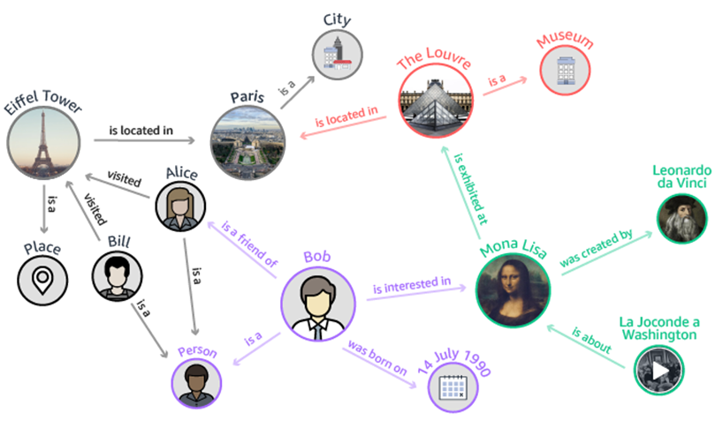
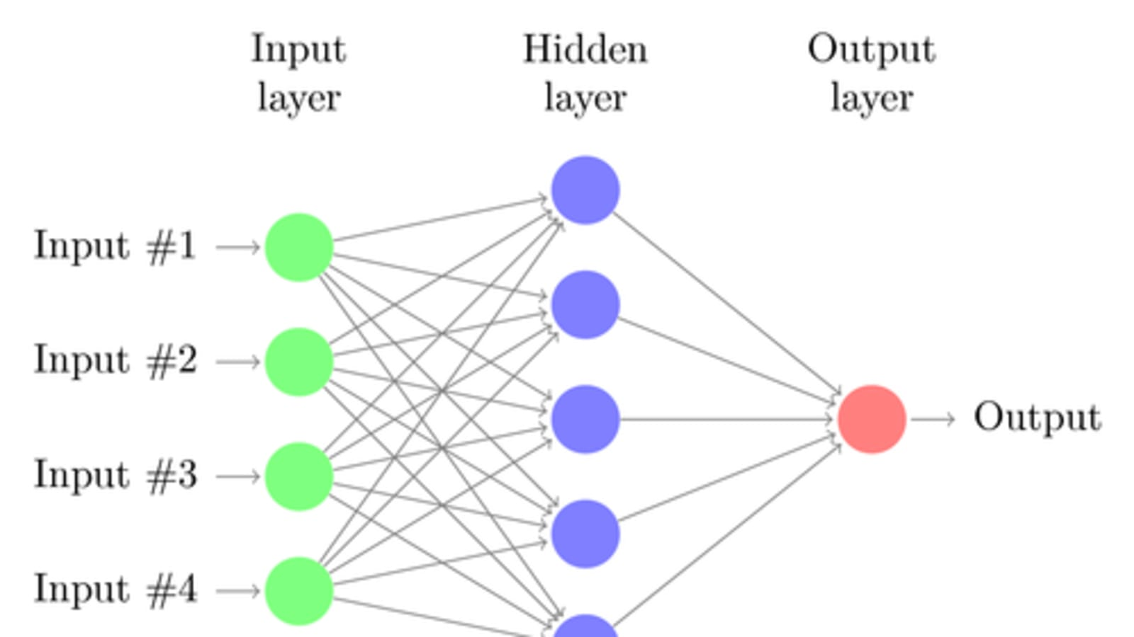
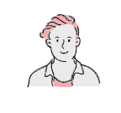
Overview
Knowledge Graph
Deep Learning Model
Human-in-the-loop

Slide 3
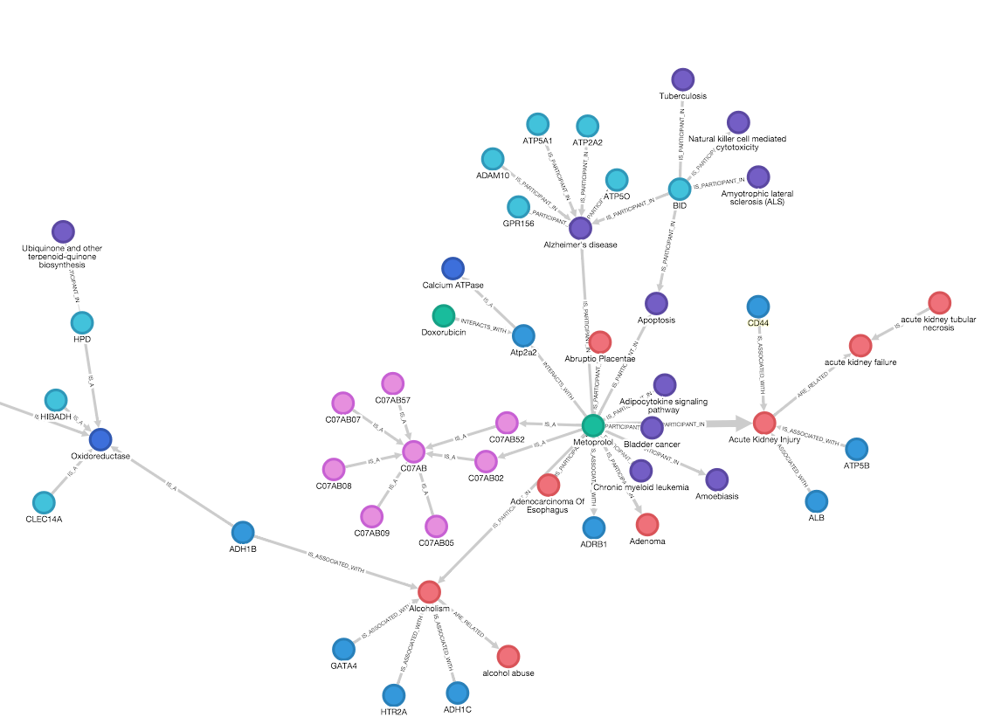
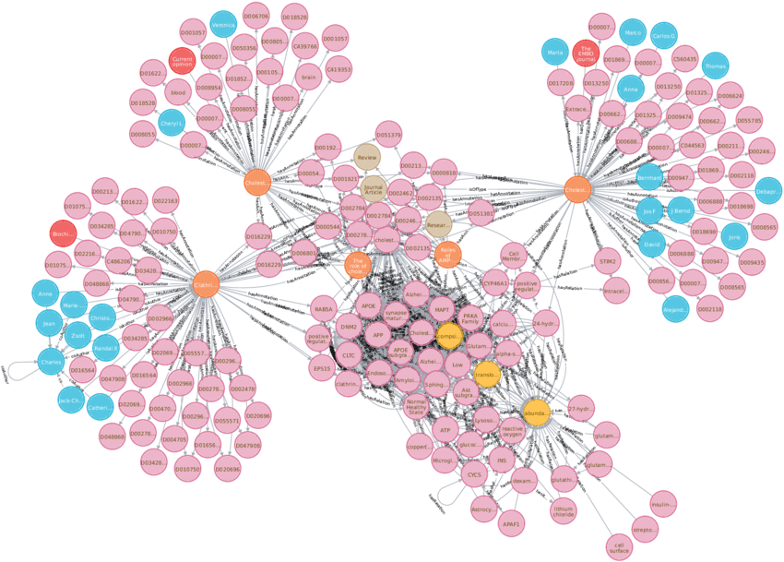
Evolving Graph
Additional information includes, detected TTPs, External threat intel from CTIH and expert knowledge
Case 1
Initial graph
Additional information
Evolving Network
Case 2
.
.
.
.
Initial graph
Additional information
Evolving Network

Slide 4
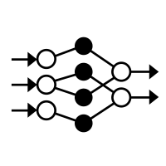

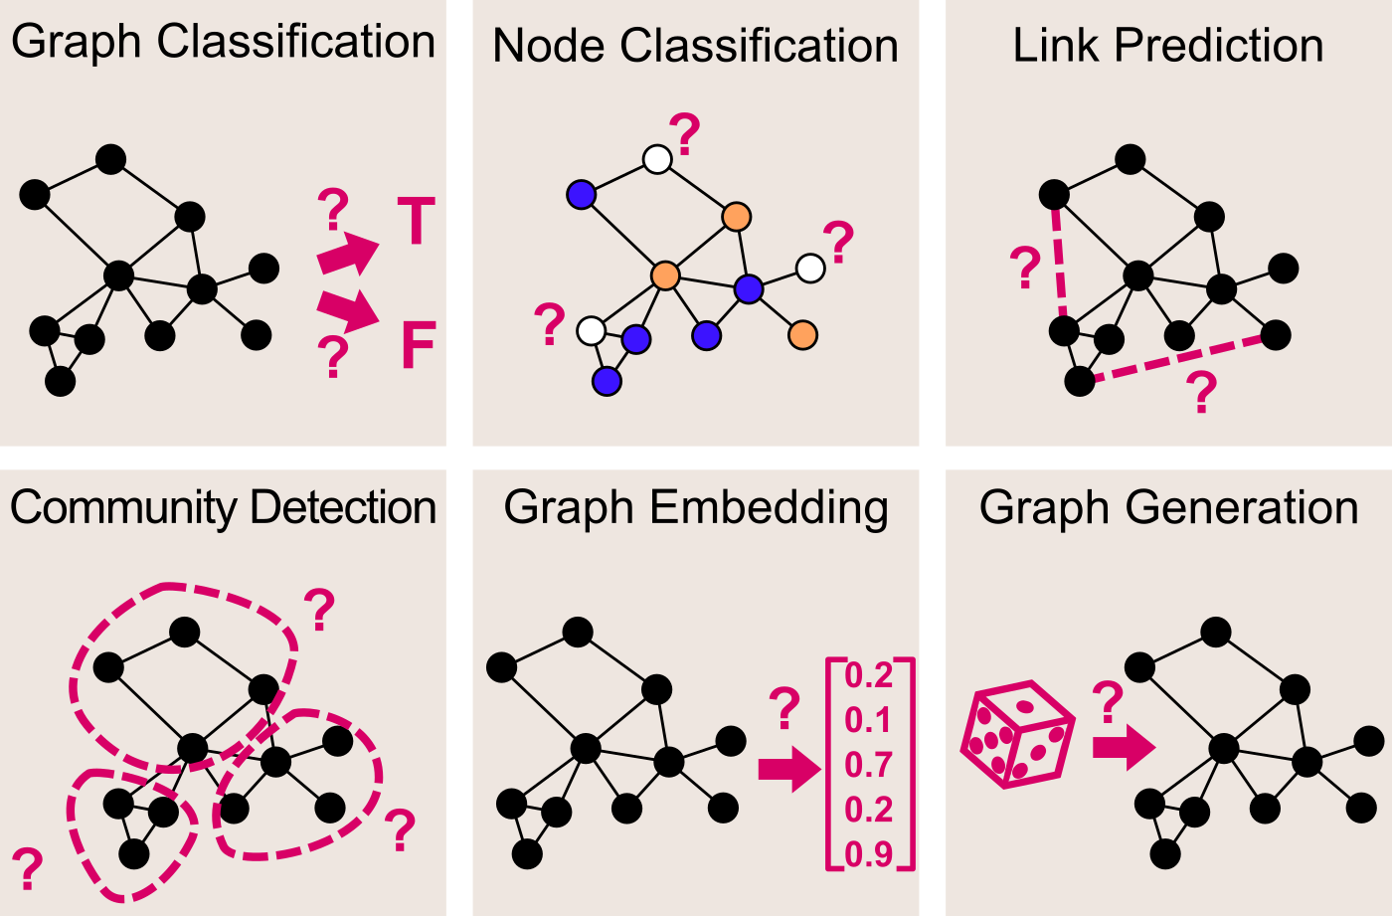


Flow of IRL module
Case Graph
Retraining
Graph Embedding
Pretrained-Model
Prediction
Expert Validator
Validated Data

Slide 5
Flow of IRL module
Training Graph Samples
Graph Embedding
Pretrained-Model
Prediction
Graph Embedding
Testing Graph Samples

Slide 6
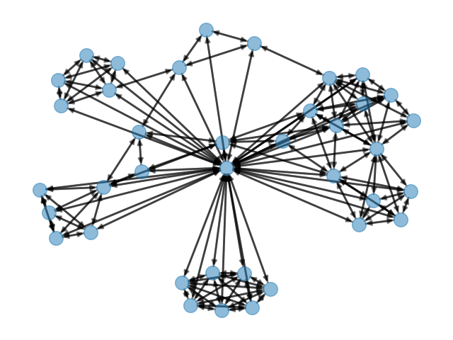
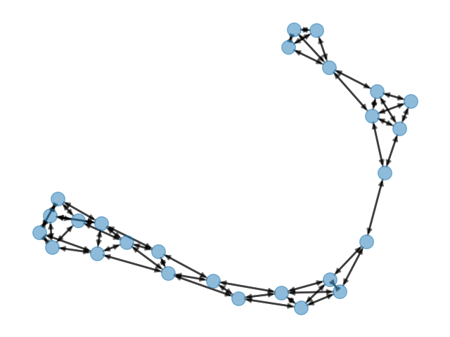
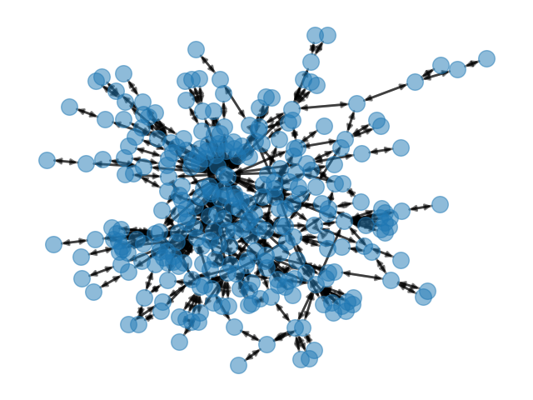
Benchmark Dataset used -
IMDB
PROTEINS
REDDIT

Slide 7
Benchmark dataset Statistics
Dataset | No. of graphs | No. of classes | No. of vertices | No. of edges
PROTEINS | 1113 | 2 | 39.1 | 72.8
REDDIT-BINERY | 2000 | 2 | 429.6 | 497.8
IMDB-BINARY | 1 000 | 2 | 19.8 | 96.5

Slide 8
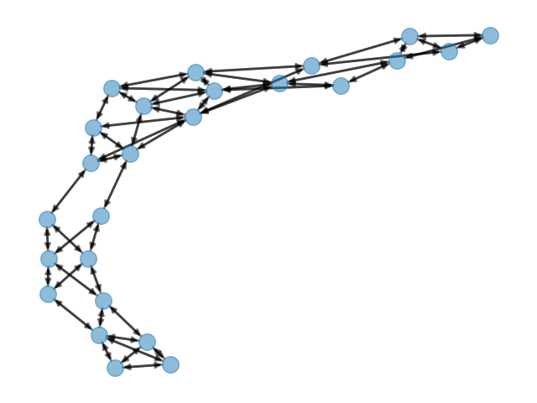
NN visualization
Graph Encoding G
ConvNet
Graph G
d(G,H)
Sigmoid(d(G,H))
Similarity
Score
Shared Weights
ConvNet
Graph Encoding H
Graph H

Slide 9


Y

Slide 10
Overview
Pre-Requisite
Train and store model with samples from each classes of crime type
Prediction Process
Create new case
Generate graph
Extract graph embedding
Make a prediction using pretrained model
Get prediction result and then query the user for confirmation
Verified labels get stored in intelligence database
User flows end while in the back end, model get retrained with new data

Slide 11
Overall Investigation steps
PHASE 1
PHASE 2
PHASE 3
1) Collect
4) Construct
7) Predict
Collecting and storing raw forensic images
Construct a knowledge graph and embed TTP information via Playbooks
When model is available, make a prediction of the crime type
2) Extract
5) Reinforce
8) Query
Extractions of required artifacts
Edit graph to embed or link additional information in the graph
Query the user for prediction confirmation
3) Prepare
9) Retrain
6) Analyze
Parsing and preprocessing of data to prepare for analysis
Retrain model once sufficient user verified labelled samples are available
Generate deductive analysis based on knowledge graph

Slide 12
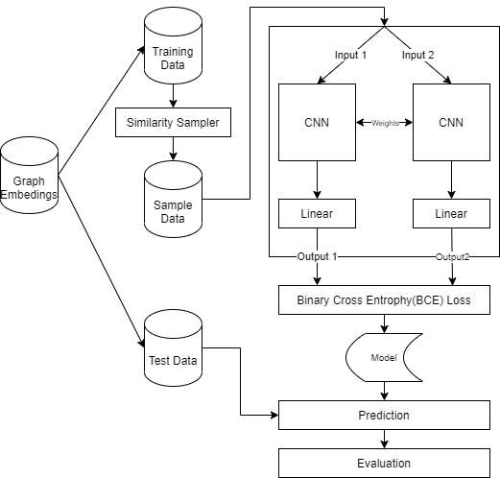
Workaround for limited training dataset
Implemented Siamese Neural Network Model
Uses similarity comparison for prediction
Like how human can differentiate between different object at a single glance
Requires the model to be trained with at least 2 samples of each classes(crimetype) for this model to provide prediction

